Slide 1
Introduction to Artificial Intelligence
Litty Tressa George
Lecturer FICT
Section 1 PPT 1

Slide 2
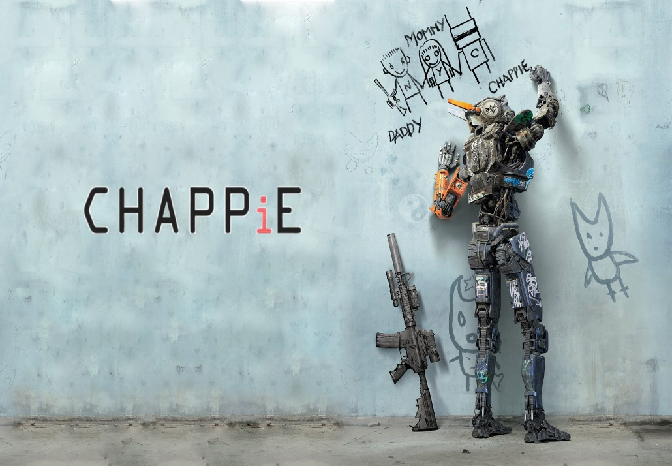
WHAT IS AI?
Artificial intelligence is the study of systems that act in a way that to any observer would appear to be intelligent.
Artificial Intelligence involves using methods based on the intelligent behavior of humans and other animals to solve complex problems.

Slide 3
Some AI Definition's.
They are organized into four categories
Systems that think like humans.
Systems that act like humans.
Systems that think rationally.
Systems that act rationally.
"The exciting new effort to make computers think . . . machines with minds, in the full and literal sense" (Haugeland, 1985) "[The automation of] activities that we associate with human thinking, activities such as decision-making, problem solving, learning ..."(Bellman, 1978) | "The study of mental faculties through the use of computational models" (Charniak and McDermott, 1985) "The study of the computations that make it possible to perceive, reason, and act" (Winston, 1992)
"The art of creating machines that perform functions that require intelligence when performed by people" (Kurzweil, 1990) "The study of how to make computers do things at which, at the moment, people are better" (Rich and Knight, 1 991 ) | "A field of study that seeks to explain and emulate intelligent behavior in terms of computational processes" (Schalkoff, 1990) "The branch of computer science that is concerned with the automation of intelligent behavior" (Luger and Stubblefield, 1993)

Slide 4
STRONG AI VS WEAK AI
The followers of Strong AI believe that by giving a computer program sufficient processing power, and by providing it with enough intelligence, one can create a computer that can literally think and is conscious in the same way that a human is conscious.
Many philosophers and Artificial Intelligence researchers consider this view to be false, and even ludicrous.
The possibility of creating a robot with emotions and real consciousness is one that is often explored in the realms of science fiction but is rarely considered to be a goal of Artificial Intelligence.
Weak AI, in contrast, is simply the view that intelligent behavior can be modeled and used by computers to solve complex problems.
This point of view argues that just because a computer behaves intelligently does not prove that it is actually intelligent in the way that a human is.

Slide 5

WEAK AI

Slide 6
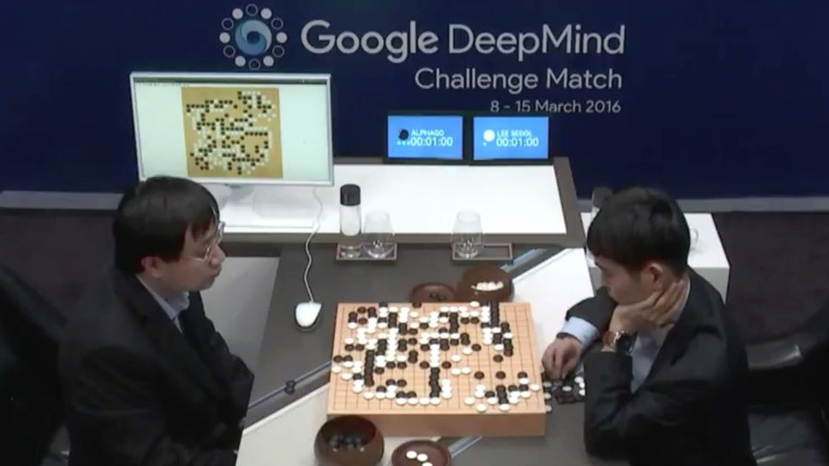
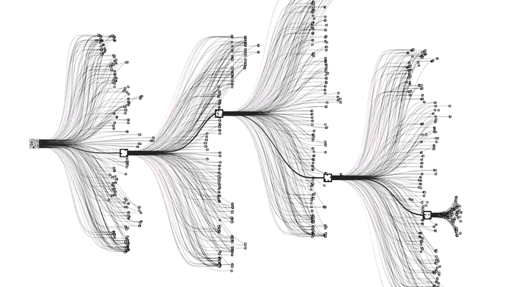
STRONG AI ?
Google DeepMind is a machine learning system that uses algorithms based on deep neural networks and reinforcement learning to train on massive datasets to be able to predict outcomes.
Google DeepMind is a prominent example of machine learning that illustrates what advanced AI.

Slide 7
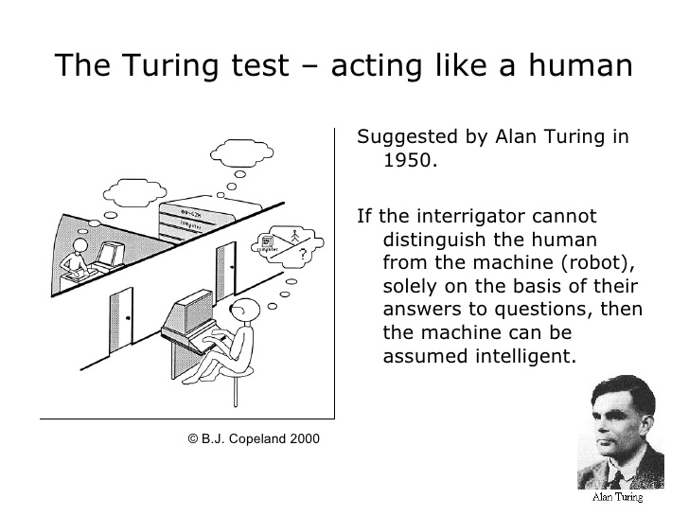
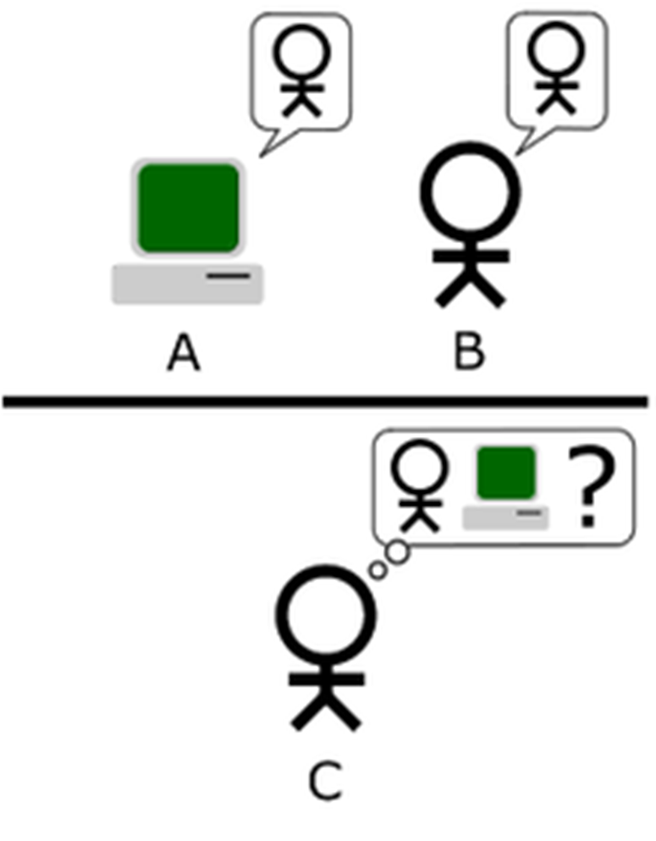

Slide 8
Searle’s Chinese Room Argument
An English-speaking human is placed inside a room. This human does not speak any language other than English and in particular has no ability to read, speak, or understand Chinese.
Inside the room with the human are a set of cards, upon which are printed Chinese symbols, and a set of instructions that are written in English.
A story, in Chinese, is fed into the room through a slot, along with a set of questions about the story.
By following the instructions that he has, the agent have to construct answers to the questions from the cards with Chinese symbols and pass them back out through the slot to the questioner.
If the system is set up properly, from the answers it gave , the questioner would believe that the agent inside the room truly understood the story, the questions, and the answers it gave.

Slide 9
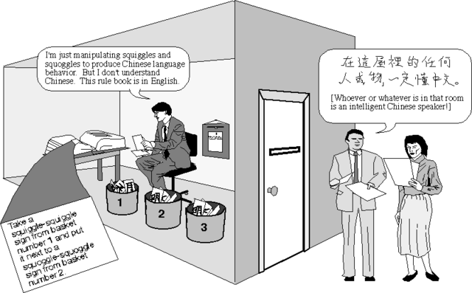
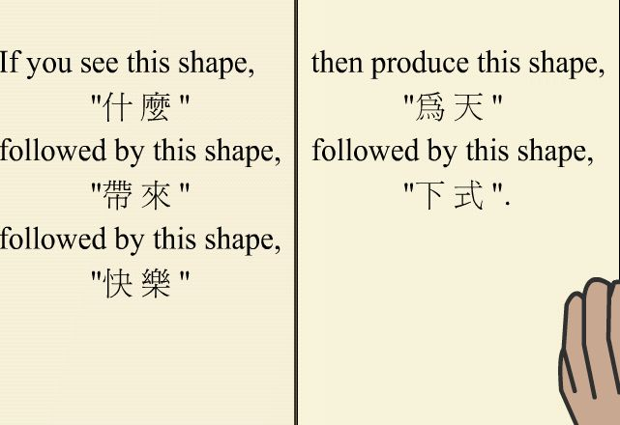
Searle’s Chinese Room Argument (contd.)

Slide 10
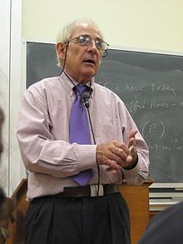
Searle’s Chinese Room Argument(contd.)
Searle’s argument
The man in the room does not understand Chinese. The pieces of card do not understand Chinese.
The room itself does not understand Chinese, and yet the system as a whole is able to exhibit properties that lead an observer to believe that the system (or some part of it) does understand Chinese.

Slide 11
The question Searle wants to answer is
1. Does the machine really understand Chinese?
2. Or is it merely simulating the ability to understand Chinese?
Searle calls the first position "strong AI"
Searle calls the second position “weak AI"

Slide 12
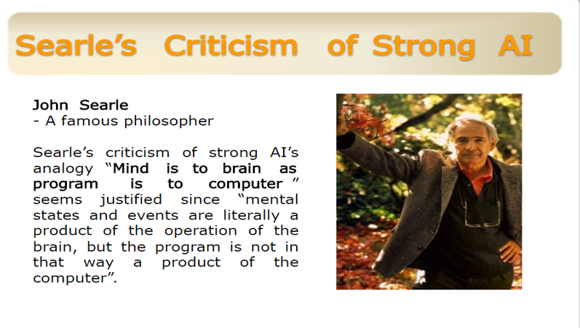

Slide 13
Activity
Divide yourself among groups of 4
Take 15 minutes to discuss if you agree with Turing or Searle?
Can mind-to-body be equated with program-to-machine ?
In the end present your findings to the class in not more than 3 minutes.
You may use internet for reference.

Slide 14
Symbolic Processing Vs Computational Intelligence
Symbolic artificial intelligence is the collective name for all methods in artificial intelligence research that are based on high-level "symbolic" (human-readable) representations of problems, logic and search.
It refers to any attempt to create AI using conventional programming language means or at a high level.
Symbolic processing tends to have variables that hold concepts like 'green, 'red, or true’.
The concept of symbolic AI itself only makes sense by being compared to non-symbolic AI.
Non-symbolic AI uses numbers to describe statistical regularities and pretends that's not symbolic

Slide 15
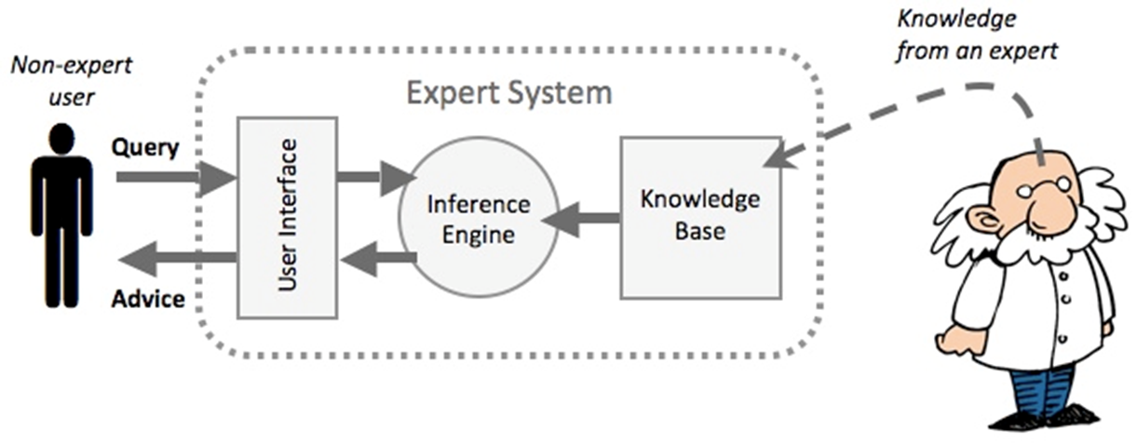
Symbolic Processing Vs Computational Intelligence cont.….
The most successful form of symbolic AI is Expert Systems [ES], which use a network of production rules.
Production rules connect symbols in a relationship similar to an If-Then statement.
The ES processes the rules to make deductions and to determine what additional information it needs, i.e. what questions to ask, using human-readable symbols.

Slide 16
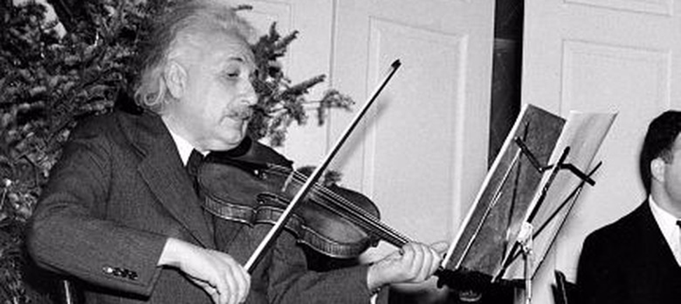
Symbolic Processing Vs Computational Intelligence cont.…
The expression computational intelligence (CI) usually refers to the ability of a computer to learn a specific task from data or experimental observation.
CI is a set of nature-inspired computational methodologies and approaches to address complex real-world problems to which mathematical or traditional modelling can be useless

Slide 17
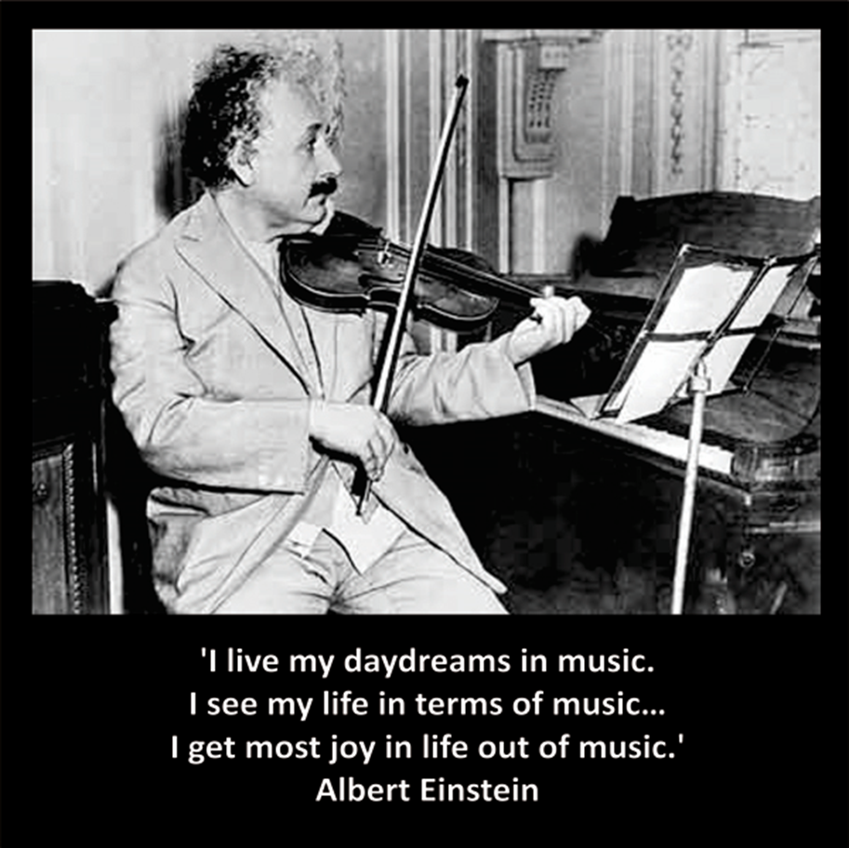
Symbolic Processing Vs Computational Intelligence cont.…
Many real-life problems cannot be translated into binary language (0’s and 1’s) for computers to process it. Computational Intelligence therefore provides solutions for such problems.
Example : Thinking about music and tunes. How do you represent it mathematically?

Slide 18
CI therefore uses a combination of five main complementary techniques :
The Fuzzy Logic: which enables the computer to understand natural language.
Artificial Neural Networks (ANN) : which permits the system to learn experiential data by operating like the biological one
Evolutionary Computing : which is based on the process of natural selection (swarm intelligence)
Learning theory : helps understanding how external effects and experiences are processed, and then helps making predictions based on previous experience.
Probabilistic methods : probabilistic methods bring out the possible solutions to a reasoning problem, based on prior knowledge

Slide 19
Black box model of computing
What’s Common To All These?
A online casino waiting for you to bet at roulette
Route finding software asking for start and destinations
A stock market trading system deciding to buy/sell euros as the price changes
E-passport gates at airports
An author selecting a part of a word and clicking the “italic” key?
“Need for Speed” Every milli-second of a racing game
An ATM waiting, blinking… always blinking …
Device, process, or system, whose inputs and outputs (and the relationships between them) are known, but whose internal structure or working is either not well, or not at all understood visually.

Slide 20

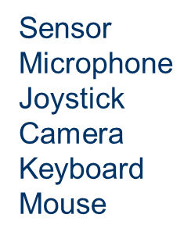

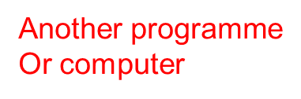
Black Box Model Of Computing

Slide 21
Black box model of computing
A Program / Function / Object method / Routine
Takes an input, or a sequence of them,
Produces an output.
A computer program is ultimately a black box
Responds to a fixed set of inputs
Outputs come from a fixed set
Most are carefully designed to be as predictable as possible.
Software testing has a role in this.
But we all know bugs occur and unexpected output happens sometimes.

Slide 22
What are the three components of the Black box model?
Model-View-Controller
Data, Input, Output
Input, Model, Output
Input, Computation, Output
Query, Database, Response

Slide 23
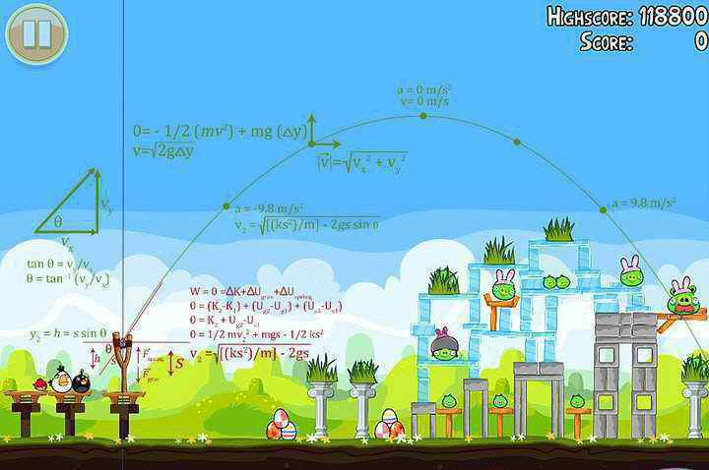
What’s in the box?
1. Long term generic knowledge
e.g. physics & mathematics logic in a game

Slide 24
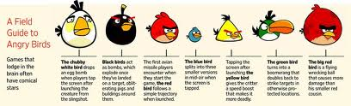
What’s in the box?
2. Long-term domain specific knowledge
Rules of the game,
Properties of things in the model
Rules /Constraints
Parameters/ Attributes

Slide 25

What’s in the box?
3. Short term/ case specific knowledge
What’s going on with this user in this game

Slide 26
Activity
What do these terms mean?
Domain
Generic
Take 5 minute to discuss with your neighbor on the above terms.
How can an understanding of these terms support problem solving?

Slide 27

Black box Model of Computing
A computing model can be defined as a
- internal representation of a system or an application.
It will be the underlying processing framework that produces the output with respect to the input given.
There will be several processing models suitable for a system or an application
Selecting the best model depends upon the goal to be achieved or task to be accomplished.
Computing models are often called as Black box models
This is because , to any user ,the input to and output from the system will only be known.
The internal structure and processing ( model) will be hiding from the users perspective.

Slide 28
Problem Categorization in view of Black box model of computing
Computing models are often called as ‘ Black Box Model ‘ because to any user of a computing system or application, the input and output will be known but not the internal computations /processing frameworks / system model will not be visualized.
In view of black box model of computing , AI problem types are categorized into the following categories.
Problem Type 1 : Input Missing
Problem Type 2 : Model Missing
Problem Type 3 : Output Missing

Slide 29
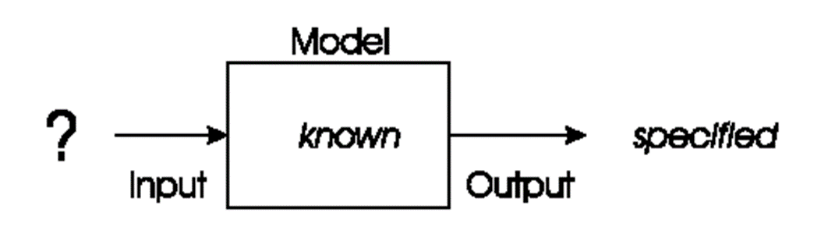
Problem type 1: Input Unknown
In these types of problems, we will have a model of our system and a specified goal / output, but seek inputs that correctly give us that goal.
The task is to choose an input or a sequence of inputs which exactly gives the specified goal.

Slide 30
Problem Type 1- Input Unknown
Example: Planning & Optimization Problems
The Planning in artificial intelligence is about the decision making tasks performed by the robots or computer programs to achieve a specific goal.
The execution of planning is about choosing a sequence of actions with a high likelihood to complete the specific task/goal.
To select all inputs (decide the inputs) → Planning is needed.
Optimization deals with finding the most best one with least error from the set , among all feasible existing set of elements in the considered set .
It is the process of finding an outcome with the most cost effective or highest achievable performance under the given constraints, by maximizing desired factors and minimizing undesired ones.
If the problem/ task is to find all possible inputs/events that leads to a particular goal/ or produce a specific output, then that is a planning problem.
If the inputs are known and the task is to find /select the best input among all inputs , then it is an optimization task/problem

Slide 31
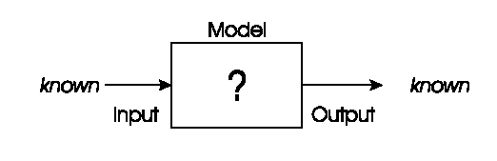
Problem type 2: Model Unknown
In these types of problems, we will have inputs to our system and a specified goal / output, but seek a model that correctly produce an output for the corresponding input given.
The task is to choose a best model which exactly gives us the correct output for the input given.

Slide 32
Problem Type 2- Model Unknown
Example: Modelling & Prediction Problems
Predictive modeling, is a mathematical technique which uses statistics for prediction.
A predictive model automatically classifies or matches the input to its appropriate matching output.
Machine Learning Models like neural networks, decision tree etc.. are example for models.
So here the task is to select the best model suitable for the considered scenario.
Problem type: Model Unknown
Given sets of inputs & corresponding outputs .
We seek a model that delivers the correct output for every known input.

Slide 33
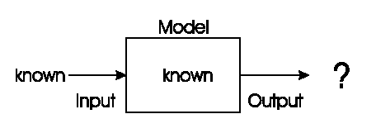
Problem type 3- Outputs Unknown.
We have a given model and wish to know the outputs that arise under different given input conditions.
The task is to find the results/ correct outputs/solutions to the given input/problem when processed by a model.

Slide 34
Problem Type 2- Output Unknown
Example: Prediction/ Recognition Problems
This output unknown problem could be for:
Recognition,
Prediction,
Simulation,
Fault Diagnosis
Prediction problems deals with the finding the outcome /solution of a new data /input which’s outcome /output is not currently clear or known. It’s an important machine learning task.
To make predictions on new inputs , prediction algorithms study similar historical data.
In order to make predictions on a new piece of input data , the system has to recognize all the hidden features & relationships of that data item with respect to similar previous historical data.
Pattern recognition is the process of recognizing patterns by using a Machine Learning algorithm. This is usually done or applied for carrying out various machine learning tasks like classification/prediction.
Examples 1. Determine the next move/ best action in a marketing campaign.
2. Finding a transaction that is occurring or occurred is fraudulent or not.
3. Finger print identification, Computer vision etc.

